Slide 1


White Box Testing

Slide 2
Data Flow Testing

Slide 3
Data Flow Testing
White box testing
Control Flow Testing
Data Flow Testing
Define / Use Testing
Slice-Based Testing

Slide 4
Data Flow Testing
Data flow testing focuses on the points at which variables receive values and the points at which these values are used (or referenced)
It detects improper use of data values (data flow anomalies) due to coding errors

Slide 5
Data Flow Testing - Static Variants
Early data flow analysis often centered on a set of faults that are known as define/reference anomalies
A variable that is defined but never used
(referenced)
A variable that is used but never defined
A variable that is defined twice before it is
used
Kill and again kill

Slide 6
Main Categories Of Data Flow Coverage
Basic blocks (segment of code without branching)
all-use
c-use (computation use) e.g a = a + b
p-use (predicate use) e.g: n!=0
all-def
du-path (definition-use-path)

Slide 7
Basic blocks, defs and uses
Identify the basic blocks
Identify all the definitions
Where variables get their values
Identify all the uses
Where variables are used
Indicate p-uses (in predicates)
Indicate c-uses (in computations)
Draw path from each definition to each use that might get data from that definition
1. s = 0;
2. i = 1;
3. while (i <= n)
{
4. s + = i;
5. i ++
}
cout << s;
cout << i;
cout << n;

Slide 8
Basic blocks, defs and uses
Identify the basic blocks
Identify all the definitions
1. s = 0;
2. i = 1;
3. while (i <= n)
{
4. s + = i;
5. i ++
}
cout << s;
cout << i;
cout << n;
▪ Where variables get their values
▪ Identify all the uses
Basic block: a part of code that executes without branching
Where variables are used
Indicate p-uses (in predicates)
Indicate c-uses (in computations)
Draw path from each definition to each use that might get data from that definition

Slide 9
Basic blocks, defs and uses
Identify the basic blocks
Identify all the definitions
Where variables get their values
Identify all the uses
Where variables are used
Indicate p-uses (in predicates)
Indicate c-uses (in computations)
Draw path from each definition to each use that might get data from that definition
1. s = 0; Def(s)
2. i = 1; Def(i)
3. while (i <= n)
{
4.
s + = i;
Def(s)
5.
i ++
Def(i)
}
cout << s;
cout << i;
cout << n;

Slide 10
Basic blocks, defs and uses
p-use: a path starts from a definition of the variable and ends in a statement in which it appears inside a certain predicate
▪ Identify the basic blocks
▪ Identify all the definitions
▪ Where variables get their values
1. s = 0;
2. i = 1;
p-use(i),
p-use(n)
3. while (i <= n)
{
Identify all the uses
c-use(i)
4.
s + = i;
Where variables are used
Indicate p-uses (in predicates)
Indicate c-uses (incomputations)
c-use(i)
5.
i ++
}
e(s)
c-use: a path starts from a definition of the variable and ends at a statement in which it is involved in computation
c-us 6. cout << s;
7. cout << i; | c-us | e(i)
n
a
c-use(i)
▪ Draw path from each definitio
to each use that might get dat from that definition
8. cout << n;
c-use(n)

Slide 11
Basic blocks, defs and uses
Identify the basic blocks
Identify all the definitions
Where variables get their values
Identify all the uses
Where variables are used
Indicate p-uses (in predicates)
Indicate c-uses (in computations)
Draw path from each definition to each use that might get data from that definition
1. s = 0;
2. i = 1;
3. while (i <= n)
{
4.
s + = i;
i ++
cout << s;
cout << i;
cout << n;
5.
}

Slide 12
Basic blocks, defs and uses
Identify the basic blocks
Identify all the definitions
Where variables get their values
Identify all the uses
Where variables are used
Indicate p-uses (in predicates)
Indicate c-uses (in computations)
Draw path from each definition to each use that might get data from that definition
1. s = 0;
2. i = 1;
3. while (i <= n)
{
4.
5.
s + = i;
i ++
}
cout << s;
cout << i;
cout << n;

Slide 13
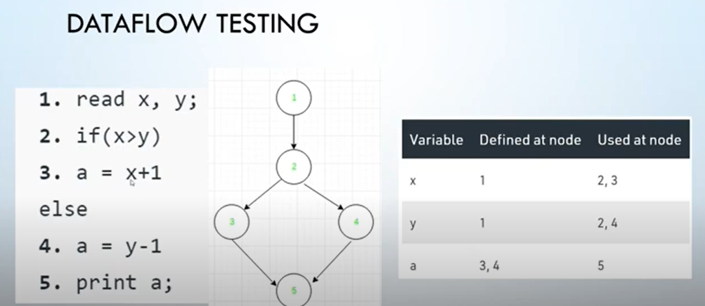

Slide 14
Data Flow Graph G(P) = (N, E)
Given a program (P) written in an imperative programming language, its program graph (G) is a directed graph in which nodes(N) are statement fragments (basic block), and edges (E) represent flow of control. In addition it details the definition, use and destruction of each of the module’s variable.

Slide 15
Notations / Symbols
d: defined, created, initialized, etc.
k: killed, undefined, released
u: used for something
c: used in a computation
p: used in a predicate

Slide 16
Notations / Symbols
~ : Leading “~” symbol means that nothing of interest (d, k, u) occurs prior to the action noted along the entry-exit path of interest
~d | the variable does not exist, then it is defined | Ok
~u | the variable does not exist, then it is used | Possibly anomalous
~k | the variable does not exist, then it is killed | Possibly anomalous

Slide 17
Notations / Symbols
~ : Trailing “~” symbol means that nothing happens after the point of interest to the exit
d~ | the variable was defined but not used on this path | Possibly anomalous
u~ | the variable was used but not killed on this path | Not anomalous
k~ | the last thing done on this path was to kill the variable | Not anomalous

Slide 18
Possible Combinations For D, K And U
dd | defined and defined again | Not invalid but suspicious
du | defined and used | Perfectly correct
dk | defined and then killed | Not invalid but probably a programming error
ud | used and defined | Acceptable
uu | used and used again | Acceptable
uk | used and killed | Acceptable
kd | killed and defined | Acceptable
ku | killed and used | A serious defect
kk | killed and killed | Probably a programming error

Slide 19
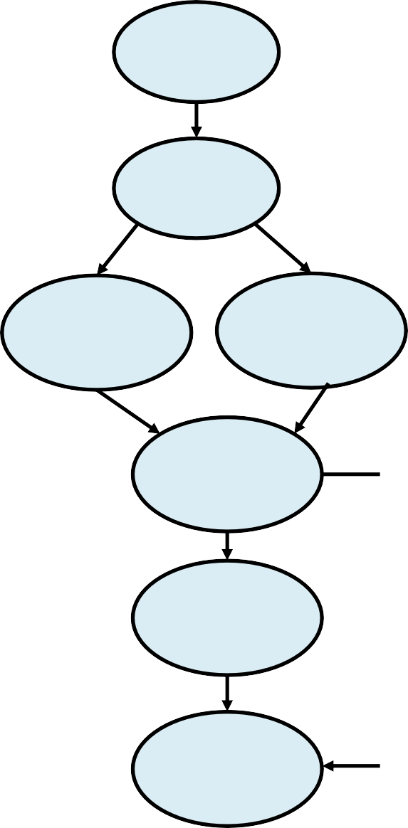
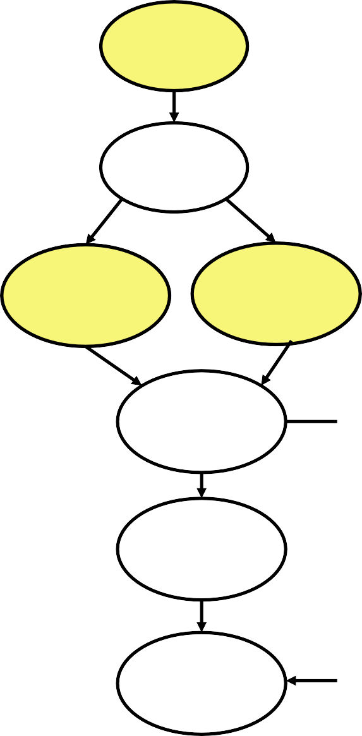
Data Flow Graphs
Variable x
define x
~d: the variable does not exist, then it is defined
~u: the variable does not exist, then it is used
~k: the variable does not exist, then it is killed
define
x
use y kill z
define x use x use z
kill z use x define z
Control flow graph annotated with define-use-kill information for x, y, z
define x use x
use x
define y use z
Variable x: define-use-kill pattern
~d: correct
dd: suspicious, programming error
du: correct
du: correct
use y use z
kill y define z

Slide 20
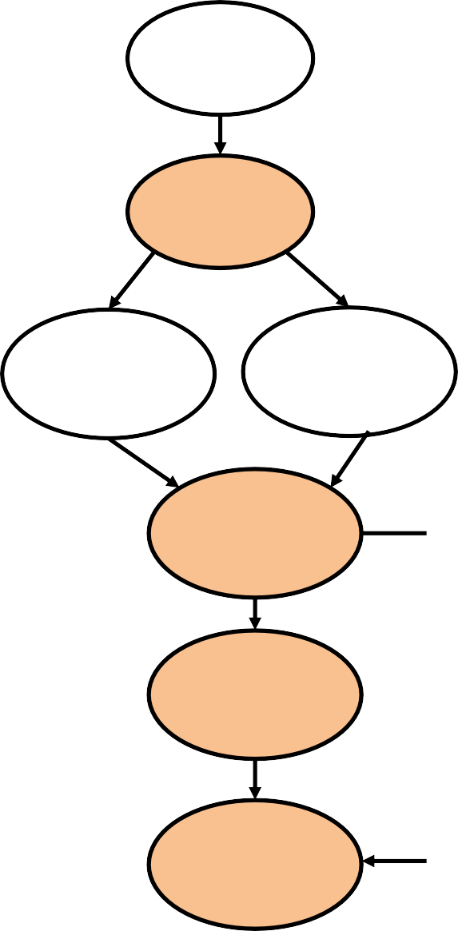
Data Flow Graphs
Variable y
define x
~d: the variable does not exist, then it is defined
~u: the variable does not exist, then it is used
~k: the variable does not exist, then it is killed
use y kill z
use y
define x use x use z
kill z use x define z
Control flow graph annotated with define-use-kill information for x, y, z
define y use z
define y
Variable y:
-----------------
~u: major blunder ud: acceptable du: correct
uk: acceptable
dk: probable programming error
use y use z
use y
kill y
define z
kill y
22

Slide 21
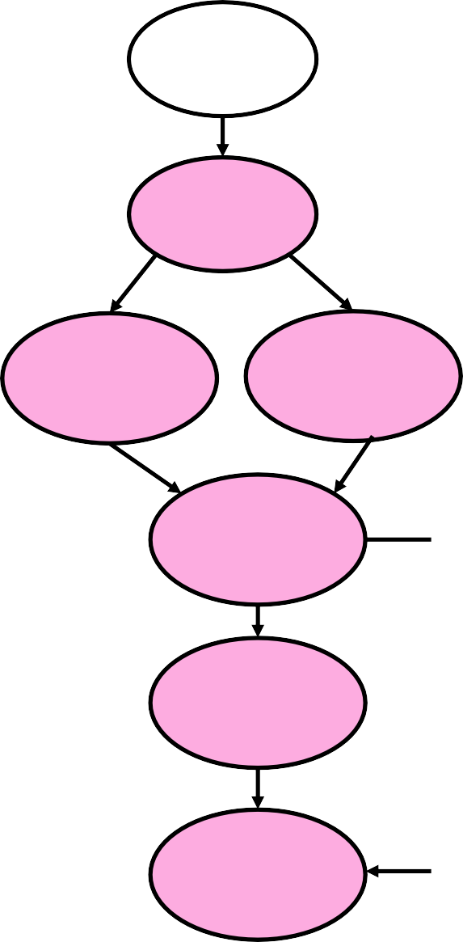
Data Flow Graphs
Variable z
define x
~d: the variable does not exist, then it is defined
~u: the variable does not exist, then it is used
~k: the variable does not exist, then it is killed
use y kill z
kill z
define x use x use z
kill z use x define z
Control flow graph annotated with define-use-kill information for x, y, z
use z
kill z define z
Variable z
---------------
~k: programming error
ku: major blunder
uu: correct
ud: acceptable
kk: probable programming error
kd: acceptable
du: correct
define y use z
use z
use y use z
use z
kill y
define z
define z

Slide 22
Slice-Based Testing
Program slice S(V, n): Given a program P and a set V of variables in P, a slice on the variable set V at statement n is the set of all statements in P that contribute to the values of variables in V
The idea of slices is to separate a program into components that have some useful (functional) meaning

Slide 23
Program slice on variable i
1. s = 0;
2. i = 1;
3. while (i <= n)
{
4. s + = i;
5. i ++
}
cout << s;
cout << i;
cout << n;

Slide 24
Program slice on variable i
1. s = 0;
2. i = 1;
3. while (i <= n)
{
4. s + = i;
5. i ++
}
cout << s;
cout << i;
cout << n;
1. s = 0;
2. i = 1;
3. while (i <= n)
{
i ++
4. s + = i;
5.
}
6. cout << s;
7. cout << i;
8. cout << n;

Slide 25
Applicability and Limitations
+ It should be used for all modules of code that cannot be tested sufficiently through reviews and inspections
Tester must have sufficient programming skill
Can be very time consuming

Slide 26
Task
a=1 b=2 c=3
a | = | 1;
b | = | 2;
c | = | 3;
if a==2
if(a==2){x else{x = x p = a/r;
= x / 2;}
+ 2;}
x=x/2
x=x+2
p=a/r
if(b/c > 3){z
= x + y;}
if b/c>3
z=x+y

Slide 27
Integration Testing

Slide 28


Unit & Integration Testing
Objective: To ensure that code implemented the design properly
Design Specification

Slide 29
Unit Testing
Component Code
Design Specification
Unit Test
Tested Components
Integration Test
Component Code
Unit Test
Tested Components
Integrated Modules

Slide 30
Stubs and Drivers
Stubs: throw-away piece of code that takes place of the actual code.
It emulates a called unit
Drivers: throw-away code that emulate the procedure calls
system
driver
Boundary conditions
independent paths
interface
…
Component to be tested
stub
stub
Test cases

Slide 31
Suppose you have a function (Function A) that calculates the total marks obtained by a student in a particular academic year. Suppose this function derives its values from another function (Function b) which calculates the marks obtained in a particular subject. You have finished working on Function A and wants to test it. But the problem you face here is that you can't seem to run the Function A without input from Function B; Function B is still under development. In this case, you create a dummy function to act in place of Function B to test your function. This dummy function gets called by another function. Such a dummy is called a Stub. To understand what a driver is, suppose you have finished Function B and is waiting for Function A to be developed. In this case you create a dummy to call the Function B. This dummy is called the driver.

Slide 32
Purpose of Integration Testing
Presumes previously tested units
Tests functionality "between" unit and system levels
Emphasis shifts from “how to test” to “what to test”

Slide 33
Approaches to Integration Testing
Based on Functional Decomposition
Top-Down
Bottom-up
Sandwich
Big Bang
Based on Call Graph
Pair-Wise
Neighborhood
Based on Paths
MM-Paths

Slide 34
Decomposition-Based
Integration

Slide 35
Decomposition-Based Integration
Top-Down
Bottom-up
Sandwich
All these integration orders presume that the units have been separately tested, thus, the goal of decomposition-based integration is to test the interfaces among separately tested units.

Slide 36
Big Bang Integration
In this view of integration, all the units are compiled together and tested at once
The draw back to this is that when a failure is observed, few clues are available to help isolate the location (s) of the fault
Execute Test Cases

Slide 37
Top-Down Integration

Slide 38

Top-Down Integration
Top Subtree

Slide 39

Top-Down Integration
Second Level Subtree

Slide 40

Top-Down Integration
Bottom Level Subtree

Slide 41
Bottom-Up Integration

Slide 42
Bottom-Up Integration
Bottom Level Subtree

Slide 43

Bottom-Up Integration
Second Level Subtree

Slide 44

Bottom-Up Integration
Top Level Subtree

Slide 45
Sandwich Integration

Slide 46
Sandwich Integration
A combination of top-down and bottom-up integration
Less stub and drivers development effort
Added difficulty to fault isolation

Slide 47
Call Graph-Based Integration

Slide 48
Pair-Wise Integration
The idea behind pair-wise integration is to eliminate the stub/driver development effort
Similar to top-down or bottom-up integration
Uses real code instead of stubs / drivers
Reduces testing effort (no need to write stubs/drivers)

Slide 49


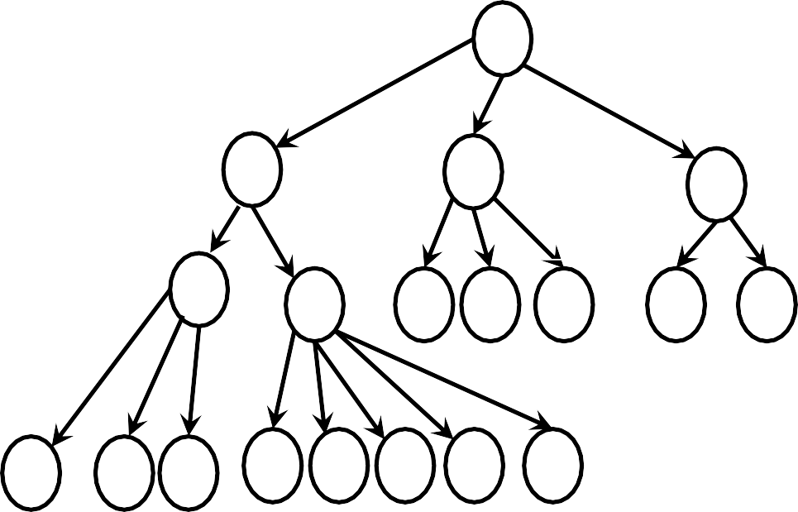


Pair-Wise Integration

